Slide 1
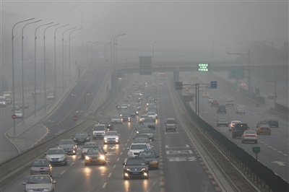
Critical Review and Meta-analysis of ambient particulate matter source apportionment using receptor models in Europe C.A. Belis, F. Karagulian, B.R. Larsen, P.K. Hopke Atmospheric Environment 69 (2013) 94-108
Presented by
Jiaoyan Huang
@ATM 790
Univ. of Nevada, Reno

Slide 2
Sections
Introduction
- air quality related models
Receptor modeling
- assumptions
- Incremental concentrations
- Enrichment ratio (ER/EF)
- Chemical mass balance (CMB)
- Principal component analysis (PCA)
- Factor analysis (FA)
Factor identification
Further discussions

Slide 3
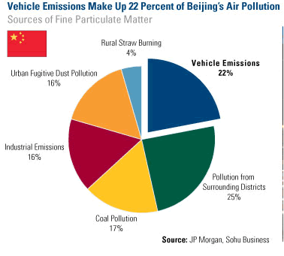
Introduction-air quality models
ALL MODELS ARE WRONG,
BUT SOME ARE USEFUL.
-Dispersion models: ISCST 3, AERMOD
-Gridded models: WRF-Chem, CMAQ, CAMx, GOES-Chem
-Receptor models: PCA, PMF

Slide 4
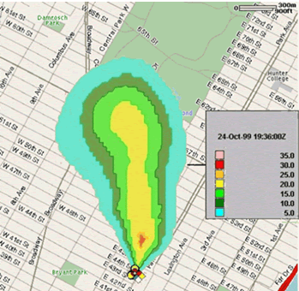
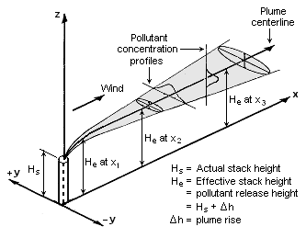
Introduction-dispersion models
http://ops.fhwa.dot.gov/publications/viirpt/sec7.htm
Advantages:
-relatively simple
Disadvantages:
-most of them do not have chemical reactions
-difficult to apply on the cases with multiple emission sources
-difficult to handle non-point sources

Slide 5
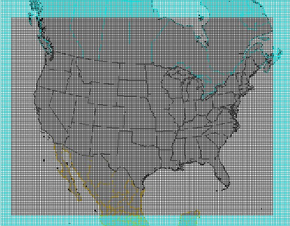
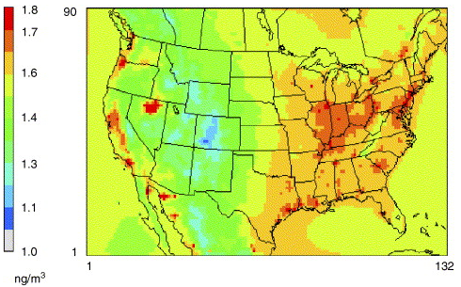
Introduction-gridded models
Advantages:
-most physical/chemical processes in the atmosphere are considered
-output with temporal/spatial variations
Disadvantages:
-need at least a small cluster computer
-emission uncertainties
-meteorological uncertainties
-not user friendly

Slide 6
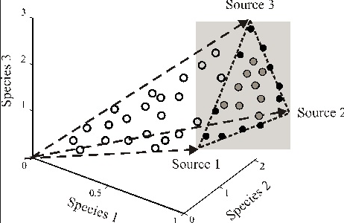
Introduction-receptor models
Advantages:
-simple and user friendly
-output with temporal variations
-can handle multiple emission sources
Disadvantages:
-assumptions are not always true
-results are varied with different locations
-most results are not quantitative
http://www.intechopen.com/books/air-quality/characteristics-and-application-of-receptor-models-to-the-atmospheric-aerosols-research

Slide 7
Receptor modeling
Filter-based measurements, IMPROVE sites
Aerosol Mass Spectrum
Metals, trace elements
Organic, carbon species
Simple correlations, multiple linear regression
CMB,PCA, PMF, PSCF

Slide 8

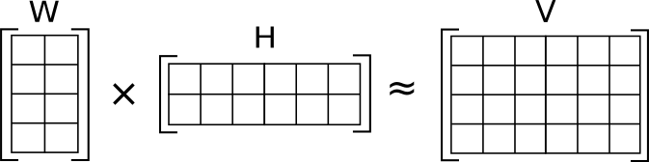
Receptor modeling
MAJOR ASSUMPTIONS
source profiles do not change significantly over time or do so in a reproducible manner so that the system is quasistationary.
receptor species do not react chemically or undergo phase partitioning during transport from source to receptor

Slide 9
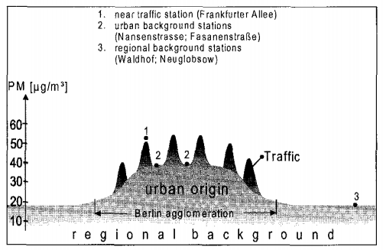
Receptor modeling Incremental concentrations approach
Lenschow et al., 2001 AE

Slide 10


Receptor modeling Enrichment Factor
c could be from sea salt (Na, Cl) and soil (Al, Ca)
-Al and Si are the most common crust/reference spices
-EFs vary with locations
-many sources could be lumped together

Slide 11

Receptor modeling Chemical Mass Balance
-emission profiles are needed
-multiple linear regression
-weighting factors with uncertainties

Slide 12
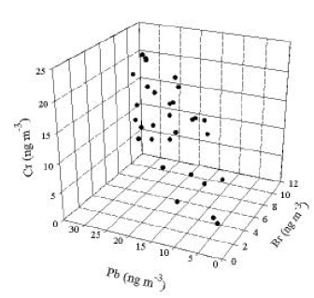
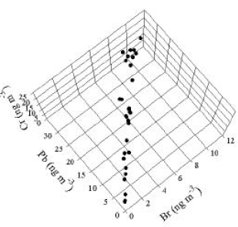

Receptor modeling Principal Component Analysis
To convert a set of observations of possibly correlated variables into a set of values of linearly uncorrelated variables
Hopke, personal communication

Slide 13
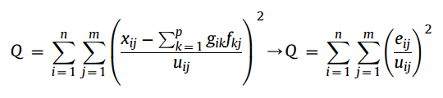
Receptor modeling Positive Matrix Factorization
A weighted factorization problem with non-negativity constraints using known experimental uncertainties as input data thereby allowing individual treatment (scaling) of matrix elements

Slide 14
Receptor modeling PCA vs FA(PMF)
PCA aims to maximize the variance by minimizing the sum of squares
FA relies on a definite model including common factors, specific factors and measurement errors
PCA has a unique solution
In PCA, variables are almost independent from each other while common factors (communalities) contribute to at least two variables
FA is considered more efficient than PCA in finding the underlying structure of data
PCA and FA produce similar results when there are many variables and their specific variances are small

Slide 15
Sources identification Organic compounds
Zhang et al., 2011 ABC
POA from fossil fuel-hydrocarbon organic aerosol
Cooking related OA-hydrocarbon organic aerosol with diurnal pattern
Biomass burning-m/z 60-73, levogluvosan
LV-OOA
SV-OOA

Slide 16
Sources identification
Sea/Road salt: Na, Cl, and Mg
Crustal dust: Al, Si, Ca, and Fe
Secondary inorganic aerosol: S, NO3
Oil combustion: V, Ni, S
Coal combustion: Se, PAHs
Mobile sources: Cu, Zn, Sb, Sn, EC, Pb
Metallurgic sources: Cu, Fe, Mn, Zn
Biomass burning: K, levoglucosan

Slide 17
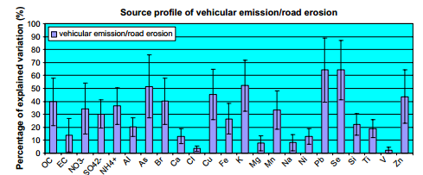
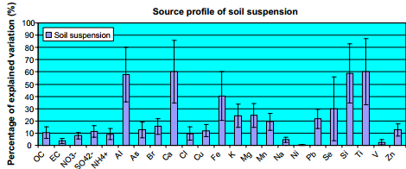
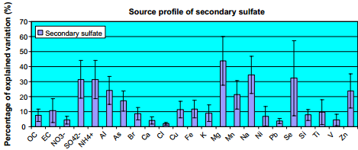
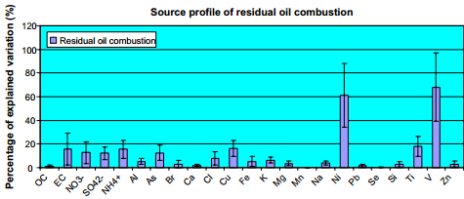
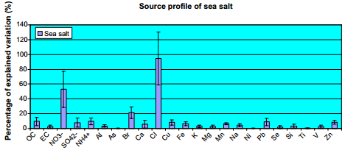
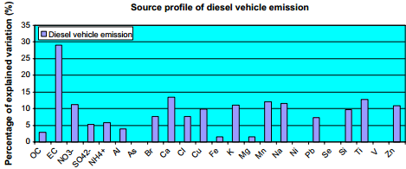
Sources identification
Receptor modeling of source apportionment of Hong Kong aerosols and the implication of urban and regional contribution
H. Guo et al. / Atmospheric Environment 43 (2009) 1159–1169

Slide 18
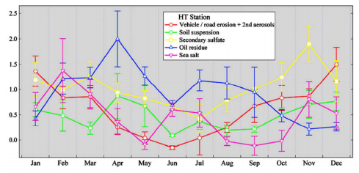
Sources identification
Receptor modeling of source apportionment of Hong Kong aerosols and the implication of urban and regional contribution
H. Guo et al. / Atmospheric Environment 43 (2009) 1159–1169

Slide 19
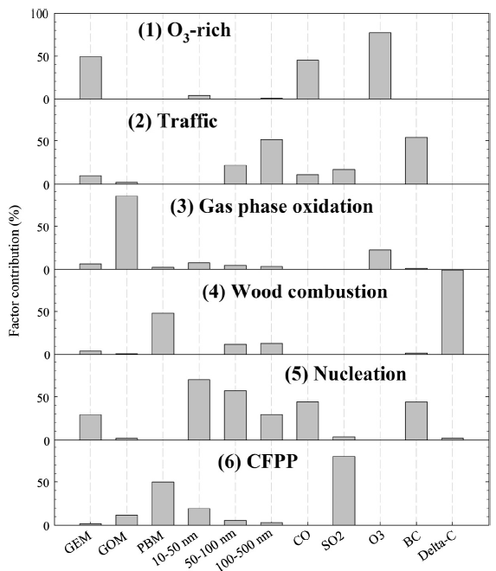
Future discussions
Y. Wang et al. / Chemosphere 92 (2013) 360–367

Slide 20
Future discussions PSCF
Sampling site
Cell 2
Cell 1
PSCF value
Cell 1 = 2/3
Cell 2 = 0/2
Back-trajectory representing high concentration
Back-trajectory representing low concentration
Notes:
The algorithm of PSCF is to count each trajectory endpoint that terminates within the grid cell.
The trajectory that contains high Hg concentration is counted to increase the probability.

Slide 21
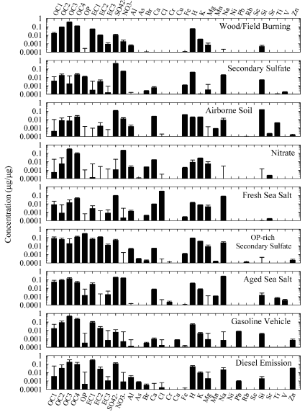
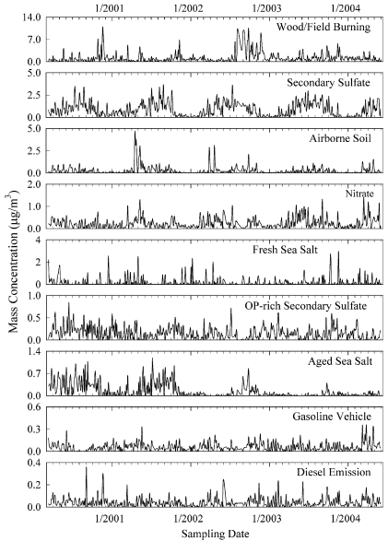
Future discussions
I. Hwang, P.K. Hopke / Atmospheric Environment 41 (2007) 506–518

Slide 22
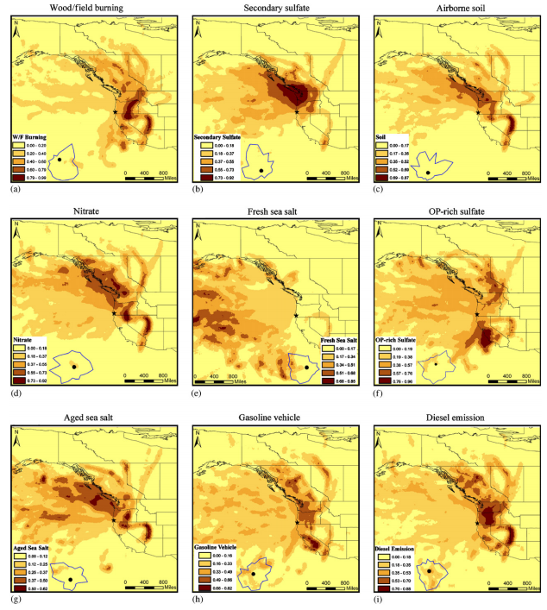
Future discussions
I. Hwang, P.K. Hopke / Atmospheric Environment 41 (2007) 506–518

Slide 23
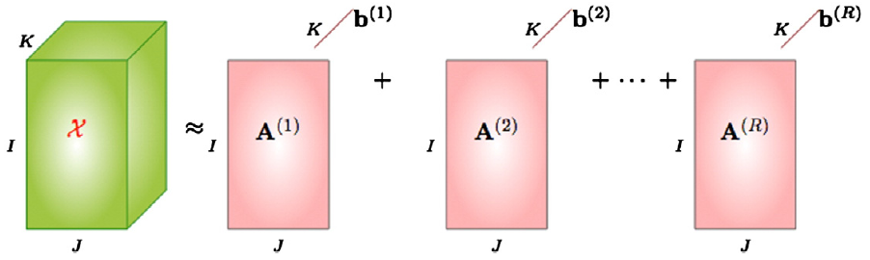
Future discussions 3D- PMF
N. Li et al. / Chemometrics and Intelligent Laboratory Systems 129 (2013) 15–20

Slide 24
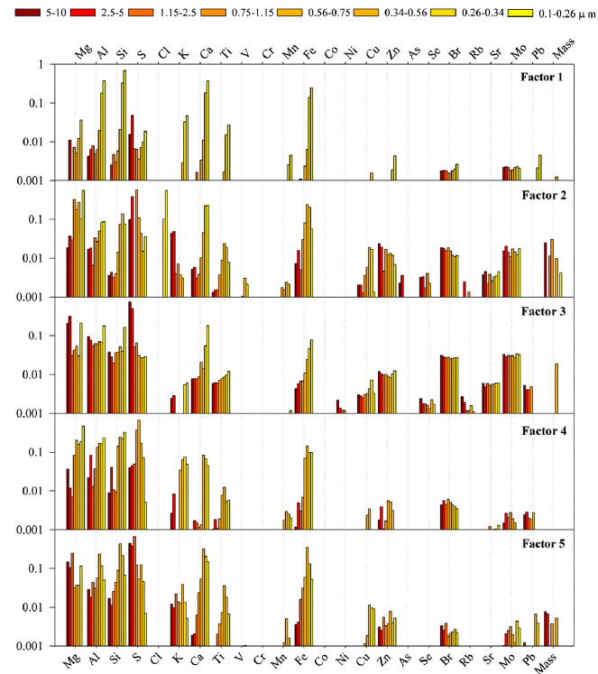
Future discussions 3D- PMF
N. Li et al. / Chemometrics and Intelligent Laboratory Systems 129 (2013) 15–20

Slide 25
Supporting information
Prof Hopke @ Clarkson Uni.
http://people.clarkson.edu/~phopke/
EPA PMF 3.0
http://www.epa.gov/heasd/research/pmf.html
EPA PMF 4.1 Prof Larson @ UW
http://faculty.washington.edu/tlarson/CEE557/PMF%204.1/
The most current version PMF 5.0 US EPA is still working on it.

Slide 26
Questions??

